Slide 1
R12 Federal Financials: Preparing for New US Treasury Reporting Requirements
Session ID#12822
Larry Baugh
Apps Ingenuity LLC
http://www.oraclefedapps.com

Slide 2
Introduction
Larry Baugh
14+ years Oracle Federal Financials Functional/Technical Experience
CPA (Inactive)
Emphasis Areas: GL, Budget Execution, Fed Admin, AR, AP, Fed Reporting, PA, PO, iProc, Proc Contracts, CLM, XML/BI Publisher, Discoverer, SQL, PL/SQL, etc
Sample Federal Customers: DOI-IBC, USAF-DEAMS, DFAS, WAPA, multiple DOE, DoD, and other Fed Civilian entities
Recent Role: Solution Architect/Co-PM for US Dept. of Interior National Business Center (DOI-NBC) Shared Services Environment Release 12.1.3 Upgrade and Sustainment
5th year presenting at Collaborate

Slide 3
Agenda
What is GTAS?
Oracle’s GTAS Answer
Deploying Oracle’s GTAS Solution
Executing GTAS Reporting
Preparing for live GTAS Reporting in FY ‘14
Objectives:
To introduce the R12 Federal Financials GTAS functionality.
Share info and experiences focused on flattening the GTAS learning curve and better enabling GTAS success across the Fed Financial community.

Slide 4


What is GTAS?
GTAS – Governmentwide Treasury Account Symbol Adjusted Trial Balance System.
GTAS will replace existing FACTS I, FACTS II, IFCS and IRAS systems and serve as the single system for reporting US Federal Agencies’ trial balance information to the US Treasury.
GTAS reporting becomes mandatory starting with Fiscal Year 2014 data. 1st required GTAS reporting will occur in early DEC ’13.
Agencies have mandatory GTAS Testing that needs to be completed by June 30, 2013.
http://www.fms.treas.gov/gtas

Slide 5
What is GTAS?
GTAS reporting includes full budgetary and proprietary trial balance reporting for all an Agency’s Treasury Account Symbols (TASs).
GTAS only allows bulk file uploads from Agency financial systems.
  Agencies and users who typically have always reported FACTS I/II manually will not be able to do this with GTAS file loads.
The transition to GTAS includes multiple Federal Financial data element changes that impact GTAS reporting.
  6 Digit USSGL
  3 digit Agency Identifier values
  Revised Fund Type values
  New Authority Duration values of ‘R’ (Receipt) and ‘F’ (Clearing/Suspense)
GTAS improves US Treasury Financial Data quality by implementing new edits and validations.
“All TAS must pass all validations and the fatal edits for the agency to successfully meet the mandatory test requirement.”

Slide 6
Oracle’s GTAS Solution
Patches for supporting the GTAS Reporting requirement released in 3 phases: Phase I – May ‘12, II – Dec ‘12 ,III – Mar ’13. (R12)
Phase III Patch (14373350) is cumulative, no need to apply the phase I/II patches.
Key GTAS My Oracle Support (MOS) Notes:
  GTAS Phase I, II, and III (Part 1) [ID 1530723.1] (R12)
  GTAS Phase I, II, and III (Part 2) [ID 1530734.1] (R12)
  11i GTAS Phase I, II and III (Part 1)[Article ID 1536888.1]
  11i GTAS Phase I, II and III (Part 2)[Article ID 1536907.1]
An additional set of enhancements (Phase IV), related to enhanced Trading Partner TAS/BETC tracking/reporting, is yet to be released. This functionality is not required for the initial GTAS go-live in FY ‘14.
The GTAS patches retire the existing FACTS I/II functionality, so GTAS patches should not be applied in Prod until finished with FACTS I/II for FY2013 reporting.

Slide 7
Oracle’s GTAS Solution*
New Concurrent Programs - Setup/Migration | PL/SQL
GTAS Migration | FV_GTAS_AGENCY_ID_UPGRADE.MAIN
GTAS Attributes Table Setup | FV_SETUP_PKG.GTAS_ATTRIBUTES
GTAS Federal Accounts Creation Process | FV_GTAS_INTERFACE.GET_FEDERAL_ACCOUNTS
Migrate FACTS End Bal to GTAS End Bal | FV_UPG_FACTS_EB_TO_GTAS
New Concurrent Programs - Reporting Execution | PL/SQL | BI Pub Data Definition
GTAS Activity Balance Creation Process | FV_GTAS_GL_PKG.MAIN
GTAS Activity Balance Exception Report |  | FVGTACTBALEXC
GTAS Interface Process | FV_GTAS_INTERFACE.MAIN
GTAS Interface Exception Report |  | FVGTINTEXC
GTAS Bulk File | FV_FLATFILES.MAIN
GTAS Bulk File Interface Report |  | FVGTINTATB
GTAS Trial Balance Report | FV_GTAS_TBAL_TRX_PKG | FVGTASTB
GTAS Transaction Register Report | FV_GTAS_TRX_REGISTER | FVGTASTR
*Based on FV.B Patch 14373350 contents
Updated Concurrent Programs - Setup | PL/SQL
Rollover Treasury Account Symbols | FV_CGAC_CRT_TAS

Slide 8

Oracle’s GTAS Solution*
New/Updated FV Professional Forms
Define Budget Codes
Define Budget Distribution
Define Budget Transaction Types
Define Federal System Parameters
Define Federal Year End Close
Define Fund Attributes
Define GTAS Attributes
Define Program Reporting Codes
Define TAS/BETC Mapping
Define Trading Partner TAS/BETC Mapping
Define Treasury Account Symbols
Define USSGL accounts
Enter Budget Authority
Enter Fund distributions
Enter Reprogramming Transactions
Federal Financial Options
Misc Updates
b13603188_gdf.ldt - Supplier DFF configs
b13603188_lkups.ldt - Lookups
b13603188_valst.ldt - Value Sets
fvcprog.ldt - Conc Programs
fvfcusgl.ldt - USSGL
fvgtattb.ldt - GTAS Attributes
fvlkups.ldt - Lookups
fvmenus.ldt - Menus
fvreqgr.ldt - Request Group updates
fvxdo.ldt - XDO LOB (XML Pub) load
odf/xdf updates (View and Table Defs)
fvbet.odf | fvfst.odf
fvfct.odf | fvfv.odf
fvfs.odf | fvgtas.odf
FV_GTAS_HEADER_ID_GT.xdf
*Based on FV.B Patch 14373350 contents
No FV_SLA Package Updates =

Slide 9
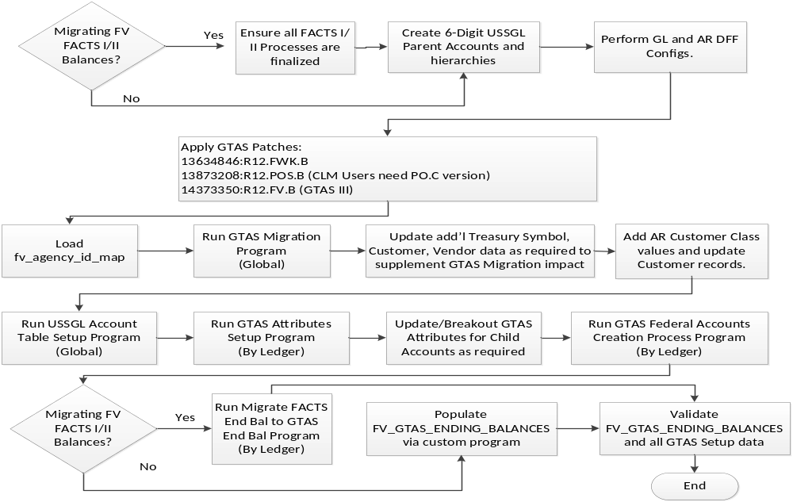
GTAS Solution Deployment
Applicable To Federal Financial Customers Live Prior to GTAS.

Slide 10
GTAS Solution Deployment
Numerous programs, scripts, and/or manual steps are necessary to properly deploy the GTAS solution and migrate the requisite ending balances.
Per MOS Note1530734.1, if an agency is not currently using the FACTS I/II functionality:
    “…the customer will be responsible for populating the GTAS Ending Balances table for the prior year post closing balances in order to provide proper 1st GTAS reportable year beginning balances.”
Agencies need to identify whether a custom conversion program will need to be developed to support this requirement.
The R12 MOS Notes 1530723.1 and 1530734.1 should be reviewed in detail to further understand all the required migration steps.

Slide 11
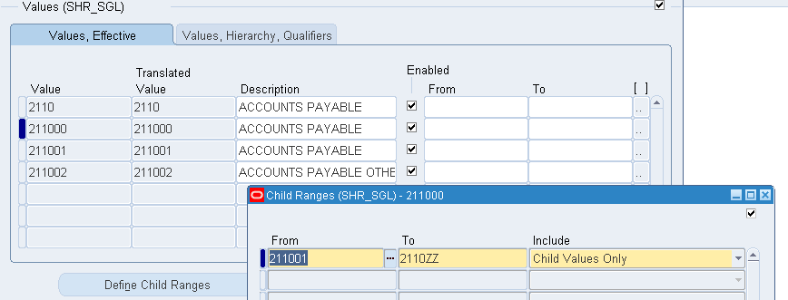
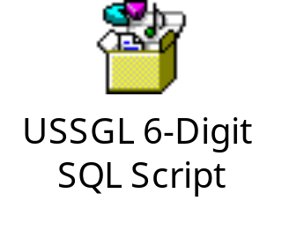
6 Digit USSGL
Can be done manually or via some semi-automated solution such as dataloader.
A PL/SQL script can be created to create the flex_values and hierarchies using APIs such as fnd_flex_loader_apis.up_value_set_value and fnd_flex_loader_apis.up_val_norm_hierarchy.
Scripting will speed subsequent test instance and prod GTAS deployment.
Currently, child ranges setup for the 6 digit parents cannot include the parent value, otherwise the GTAS Federal Accounts Creation Process will not work properly, e.g. for parent 211000:
  Range of 2110 -> 2110ZZ results in downstream problems
  Range of 211001 -> 2110ZZ is successful downstream.

Slide 12
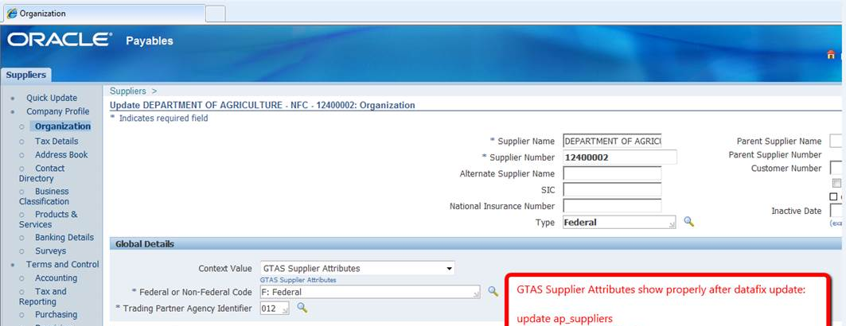
New Supplier DFF Fields
Patches 13634846:R12.FWK.B and 13873208:R12.POS.B are related to the new Supplier Form Global DFF configuration designed to support GTAS requirements.
For Oracle R12 Contract Lifecycle Management (CLM) customers on the POS.C code-line branch, a patch is not yet available that provides the requisite update to ByrSuppAMImpl.class. The fix is intended to allow for the Global Details region to be rendered for Federal Financials (typically this is only enabled when localizations are enabled).
Here is the Global Details Region rendered

Slide 13
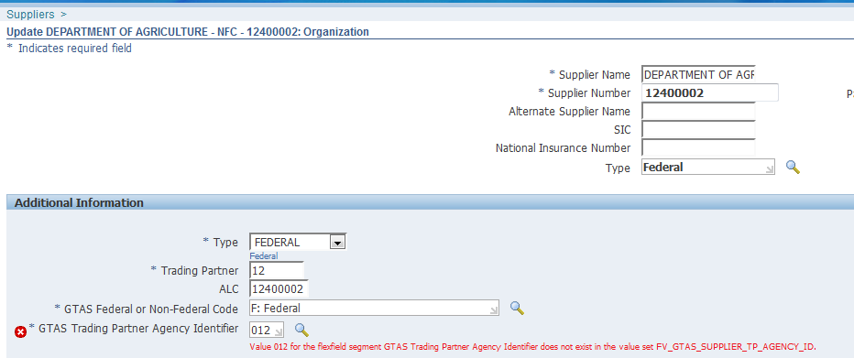
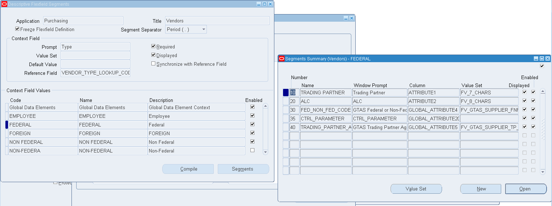
New Supplier DFF Fields
As a temporary workaround, any CLM customers can re-configure the standard PO Vendors DFF to expose the applicable ap_supplier GTAS fields to support testing.

Slide 14
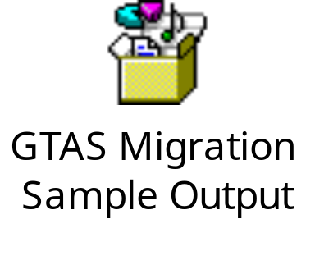
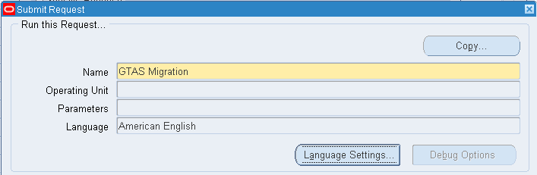
GTAS Migration Program
The standard new GTAS Migration program (FV_GTAS_AGENCY_ID_UPGRADE pkg) will convert FV treasury symbol data, along with Customer/Supplier Trading partner data to new values.
The program will execute the upgrade for all ledgers in an environment at once.
In addition to the seeded migration capability, agencies will almost certainly need to supplement with additional updates.
fv_treasury_symbols, fv_facts_federal_accounts, ap_suppliers, hz_cust_accounts records should be reviewed diligently to ensure data is migrated properly.
Suggest scripting additional required updates.

Slide 15
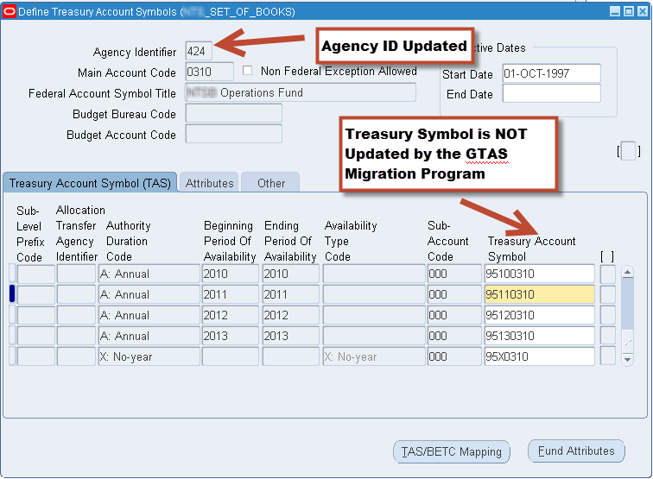
GTAS Migration Program
The seeded GTAS Migration program does not update Treasury Account Symbol values to the new 3-Digit Agency ID values. Although not required, this disconnect can become confusing to users and agencies may want to consider updating the values manually or via script.

Slide 16
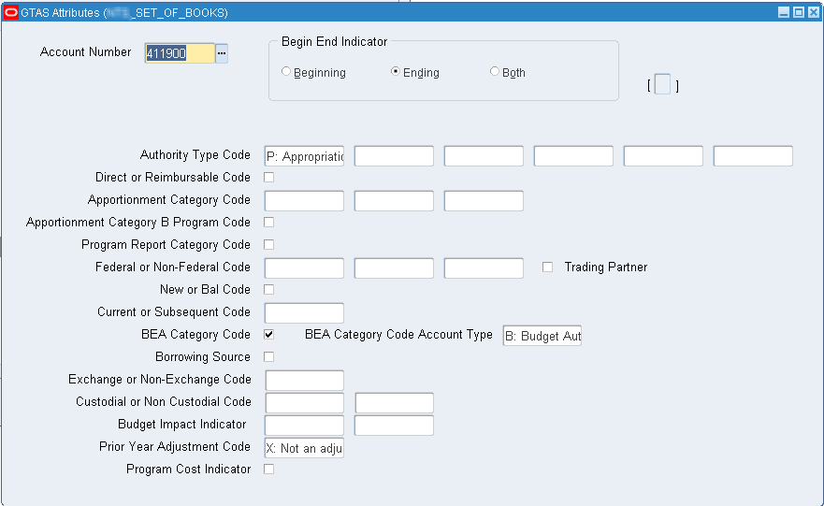
GTAS Attributes
GTAS Attributes Table Setup Process
Loads up the FV_GTAS_ATTRIBUTES table with seeded attribute data provided.
Needs to be run for each ledger that will be reporting GTAS.
Seeded data can be changed/enhanced.
Mirrors FACTS I/II Attributes.

Slide 17

GTAS Federal Accounts Creation
GTAS Federal Accounts Creation Process
Loads up the FV_GTAS_FED_ACCOUNTS table with “…records for GL accounts that require GTAS attributes that cannot be derived directly from the Accounting Flexfield.”
Needs to be run for each ledger that will be reporting GTAS.
Mirrors FACTS I Federal Accounts Creation Process.

Slide 18
GTAS Ending Balance Migration
Migrate FACTS End Bal to GTAS End Bal
Loads up the FV_GTAS_ENDING_BALANCES table prior year ending balances based on FACTS I, FACTS II and gl balances.
Ending Balance Data is populated by CCID and the GTAS attributes.
    Needs to be run for each ledger that will be reporting GTAS.
    If this process is not utilized: “…the customer will be responsible for populating the GTAS Ending Balances table for the prior year post closing balances in order to provide proper 1st GTAS reportable year beginning balances.”
    Additional indexing on the existing FACTS tables will help performance of this conversion process.
        CREATE INDEX FV.XXAAA_FV_FACTS_END_N1 ON FV.FV_FACTS_ENDING_BALANCES (ACCOUNT_NUMBER ASC, SET_OF_BOOKS_ID ASC, FISCAL_YEAR ASC)
        CREATE INDEX FV.XXNBC_FV_FACTSII_END_N1 ON FV.FV_FACTSII_ENDING_BALANCES (ACCOUNT ASC, SET_OF_BOOKS_ID ASC, FISCAL_YEAR ASC)

Slide 19
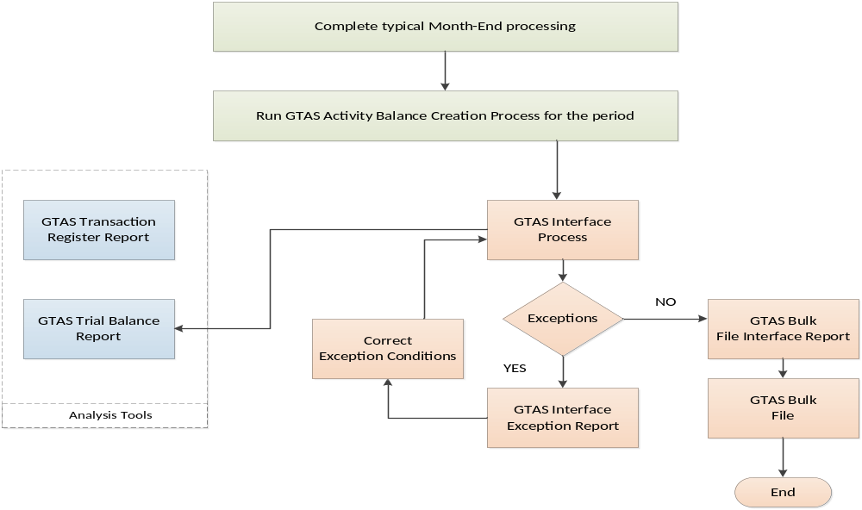
GTAS Reporting

Slide 20
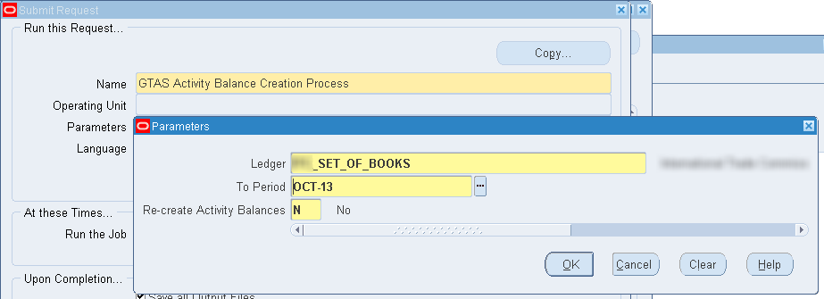
GTAS Activity Balance Creation
GTAS Activity Balance Creation Process
Populates FV_GTAS_ACTIVITY_BALANCES table“…with GTAS attribute data that cannot be derived directly from segments on the Accounting Flexfield.”
Mirrors FACTS I Journal Creation Process.
Can recreate the whole current year or leave current data as-is and supplement.
Attributes derived include: Authority Type Code, Trading Partner Agency Identifier, Trading Partner Main Account.
Exception Report will identify issues.
Currently, a bug in the FV_GTAS_GL_PKG. GET_AUTHORITY_TYPE_CODE procedure causes failures when used with multiple ledgers.

Slide 21
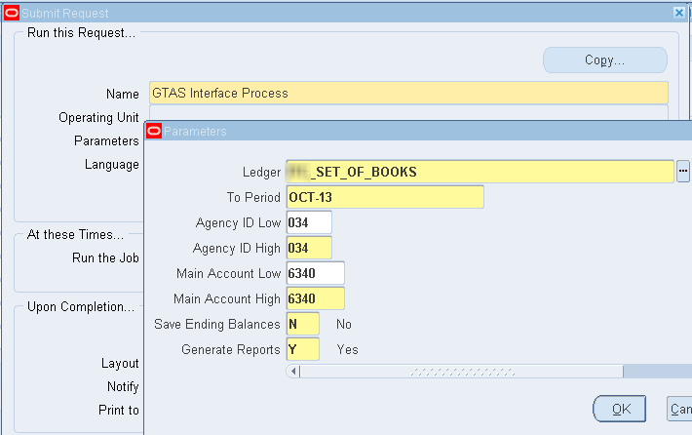
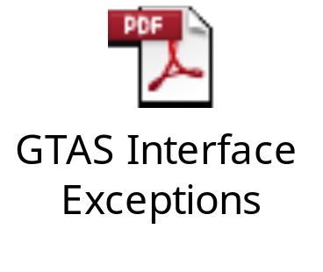

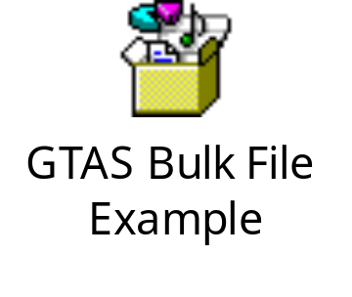
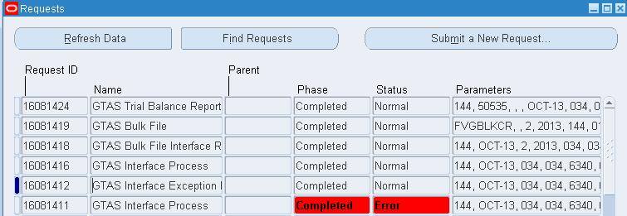
GTAS Interface Process
Populates FV_GTAS1_PERIOD_ATTRIBUTES table to stage the data for creating the GTAS Bulk File Extract.
Populates FV_GTAS1_REPORT_T2 with Exception Data encountered.
Produces GTAS Interface Exception Report or GTAS Bulk File Interface Report/Bulk File as applicable.

Slide 22
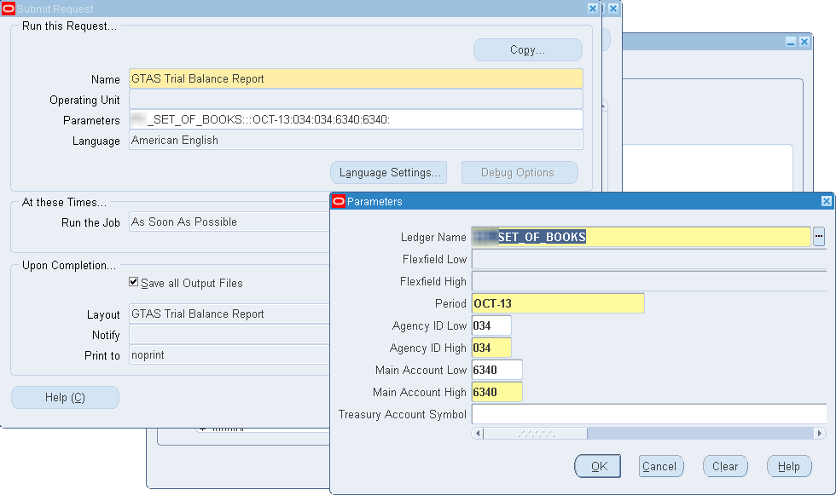
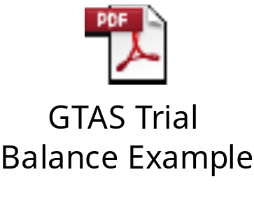
GTAS Trial Balance
Populates FV_GTAS1_REPORT_T2 temp table and produces a rolled-up Trial Balance Report based on FV_GTAS_ENDING_BALANCES, FV_GTAS_ACTIVITY_BALANCES, and FV_GTAS1_PERIOD_ATTRIBUTES data.
Built as a BI Publisher report, which enables easy layout modification as desired.

Slide 23
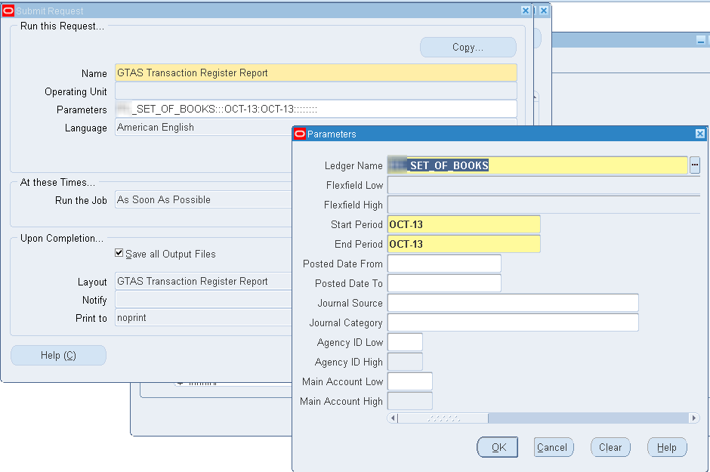
GTAS Transaction Register
Populates FV_GTAS_TRX_REG_TEMP temp table and produces a transaction-level report by GTAS Attribute Breakout.
This report is completely independent of the other GTAS staging table data…this presents a chance of reconciliation issues.
Built as a BI Publisher report, which enables easy layout modification as desired.
Performance tuning may likely be needed.

Slide 24
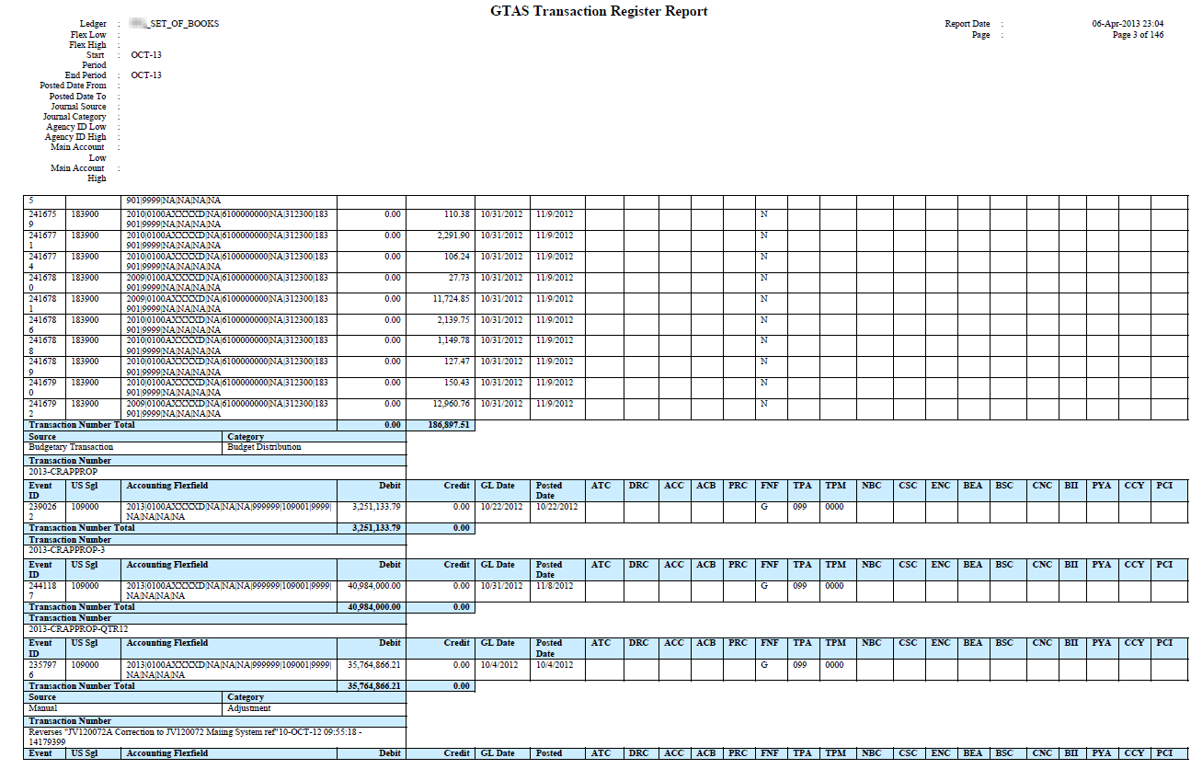
GTAS Transaction Register

Slide 25
Preparing for Dec’ 13 (FY14)
Continue working with Oracle’s GTAS solution in test to shake out additional bugs.
Clean-up Fed Financials Treasury Symbol data element values to ensure compliance with the Super Master Account File (SMAF) values.
Clean-up any Trial Balance issues that fail GTAS edits.
Document GTAS configurations precisely to migrate configurations to production properly.
Test existing and newly entered data to ensure the GTAS code is reporting data properly.
If upgrading to R12 during FY14 or after, suggest testing to make sure 11i and R12 data is reported properly by the R12 GTAS extract programs.
Identify areas of poor performance with the GTAS code and investigate tuning methods to improve run-times.
Get Reporting POCs up to speed on GTAS.
Identify timelines/processes for ensuring processing is complete in time to support bulk-file creation.

Slide 26
Summary
Mandatory GTAS Testing is here and FY14 GTAS Reporting is coming soon.
Oracle’s GTAS solution is designed to meet the GTAS requirements, but the solution is a bit immature since it is brand new. Bug fixes are needed.
A GTAS ending balances solution is needed. Agencies may need to develop a custom solution, use the seeded process to copy FACTS I/II ending balances or some combination.
A variety of clean-up efforts will likely be required to ensure GTAS success.
Live Testing with GTAS will be the best confirmation of successful GTAS Readiness.

Slide 27
Thanks for attending
Questions/Comments??
Larry Baugh
Larry.Baugh@AppsIngenuity.com
Blog - http://www.OracleFedApps.com
Twitter - @OracleFedApps
www.linkedin.com/in/larrybaugh
Be sure to check the blog for the
latest version of this and other presentations.

